Slide 1
TIME SERIES ANALYSIS AND APPLICATIONS
Prof. Luana Medeiros Marangon Lima, Ph.D.
Durham, June 15th 2023
Energy Data Analytics PhD Student Fellows Workshop

Slide 2





Let’s start with introductions…
Originally from Brazil
B.Sc. & MS. , Electrical Engineering
FEDERAL UNIVERSITY OF ITAJUBÁ, Brazil, 2005 & 2007
Electrical Power Systems
Ph.D., Operations Research and Industrial Engineering
UNIVERSITY OF TEXAS, Austin, TX, 2011
Modeling and Forecast of Brazilian Reservoir Inflows via Dynamic Linear Models under Climate Change Scenarios
Joined the Nicholas School in Jan 2018 and the EI/NIEES in July 2019
Recent courses: Time Series Analysis for Energy Data, Environmental Data Analytics, Modeling for Energy Systems, Economics of Modern Power Systems
Research and work experience: Renewable energy development and integration, Co-Optimization of Water & Energy Systems, Power System Economics, Climate Change effect on energy production
Notes:
Add pics

Slide 3
Agenda
Intro to Time Series Analysis
Background and motivation
TS Definition and Components
Examples of TS Models
Applications to Energy
Time Series Decomposition
Trend component and seasonal component
How to identify/estimate components
Case Study
Forecasting

Slide 4
Intro to Time Series Analysis
Background and Motivation
TS Components
TS Models

Slide 5
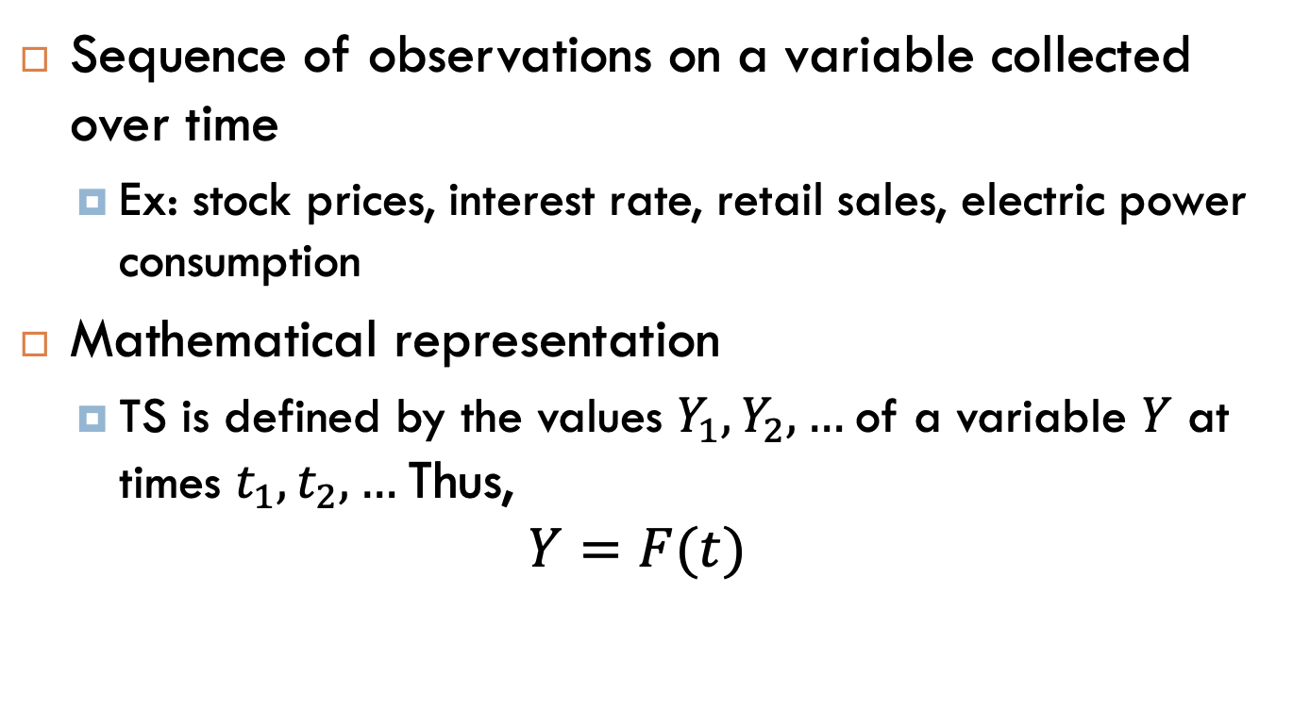
What is a Time Series (TS)?
Sequence of observations on a variable collected over time
Ex: stock prices, interest rate, retail sales, electric power consumption
Mathematical representation
TS is defined by the values $Y_{1}, Y_{2}, …$of a variable $Y$ at times $t_{1}, t_{2}, …$Thus,
$$Y=F(t)$$
Notes:
Missing pic

Slide 6
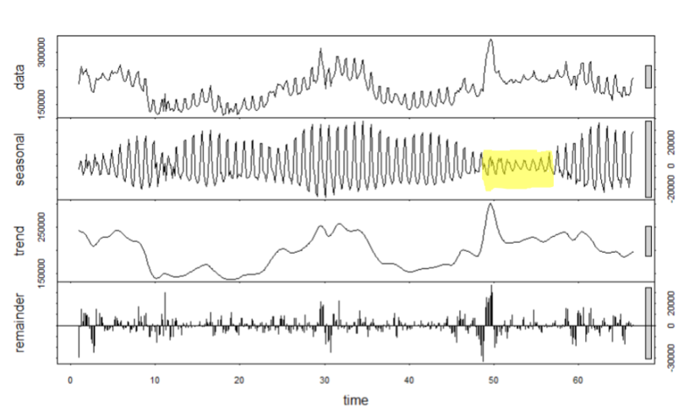
Causes of Variation in TS data
Calendar: seasons, holidays, weekends
Example
Video game usage over time – daily basis
Interest
Trend of usage over time
Popularity of games
Weekly cycle of usage
Knowledge
Usage up on the weekend and down during the week
Increased usage during holidays
Summer time: weekdays/weekends blend together

Slide 7
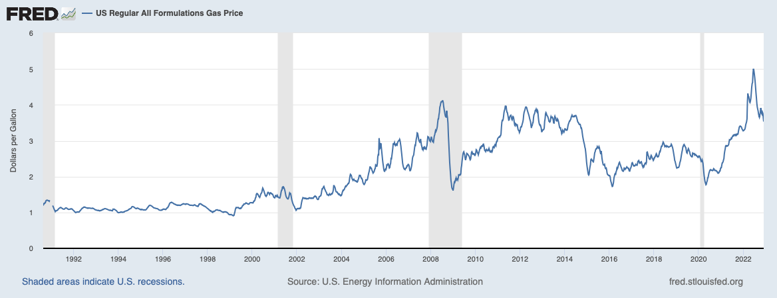
Causes of Variation in TS data
Natural calamities: earthquake, epidemic, flood, drought
Human: Political movements or changes, policies, war
Example
Source: https://fred.stlouisfed.org/series/GASREGW#

Slide 8
Time Series Components
A time series may have the following components:
Trend Component
Seasonal Component
Cyclical Component
Random Component
Decomposing the Time Series means separating trend/cycle, seasonal and random components.
TSA will find and exploit predictable patterns/components.

Slide 9
What is Time Series Analysis (TSA)?
In TSA, we analyze the past behavior of a variable in order to predict its future behavior
Filtering and Preparation
Trend
Estimation
Model Parameter estimation
Forecasting
Forecast
Stationarity Test
Outliers
Model accuracy
Auto Correlation Function
Partial Autocorrelation Function
Seasonality
Missing Data
Initial Plots
Model Selection
Notes:
If a value from yesterday or last month, or last year can help you predict the value for today, then these time series techniques are appropriate

Slide 10
Why Learn Time Series Analysis?
Forecasting and Prediction
Resource Optimization
Understanding temporal patterns and dependencies in the data
Anomaly Detection and Intervention
Policy Formulation and Evaluation
Data-Driven Decision Making
Risk Management
Critical skill in today's data-driven world
Widely applicable across various industries and domains

Slide 11
Examples of Time Series Models
Autoregressive Integrated Moving Average (ARIMA)
combines three components: autoregression (AR), differencing (I), and moving average (MA)
Seasonal Autoregressive Integrated Moving Average (SARIMA)
extension of ARIMA that incorporates seasonal components
Exponential Smoothing Models: Exponential
Simple Exponential Smoothing (SES), Holt's Linear Exponential Smoothing, and Holt-Winters' Seasonal Exponential Smoothing
Seasonal Decomposition of Time Series (STL): STL is a method that decomposes a time series into seasonal, trend, and residual components

Slide 12
TSA Applications to Energy
Energy demand forecasting for resource planning, load balancing, and infrastructure development
Renewable energy forecasting to facilitate solar and wind power grid integration
Forecasting energy prices to inform trading strategies and risk management
Energy storage optimal sizing and dispatch strategies for energy storage systems
Identifying abnormal energy consumption or production patterns that may indicate equipment malfunction or faults
Load profiling for dynamic pricing structures and personalized tariffs/rates to incentivize energy efficiency

Slide 13
Time Series Decomposition
Trend Component
Seasonal Component

Slide 14
Trend Component
Long-term tendency
Increase (upward movement) or
Decrease (downward movement)
Trend can be linear or non-linear
Ex: Upward Linear Trend
Ex: Quadratic Trend
Most of the time we assume a rolling average to simplify the analysis

Slide 15
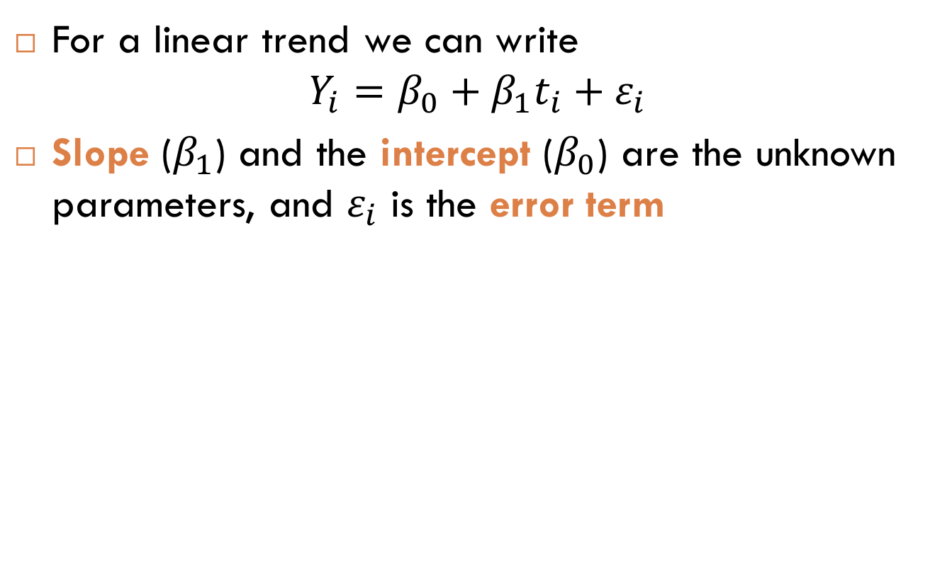
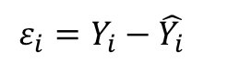
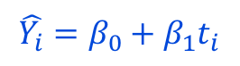
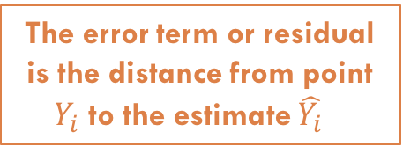
Linear Trend Component
For a linear trend we can write
$$Y_{i}=β_{0}+β_{1}t_{i}+ε_{i}$$
Slope ($β_{1}$) and the intercept ($β_{0}$) are the unknown parameters, and $ε_{i}$ is the error term
$${\hat{Y_{i}}=β}_{0}+β_{1}t_{i}$$
The error term or residual is the distance from point $Y_{i}$ to the estimate ${\hat{Y_{i}}}_{}$
$$ε_{i}=Y_{i}−\hat{Y_{i}}$$

Slide 16
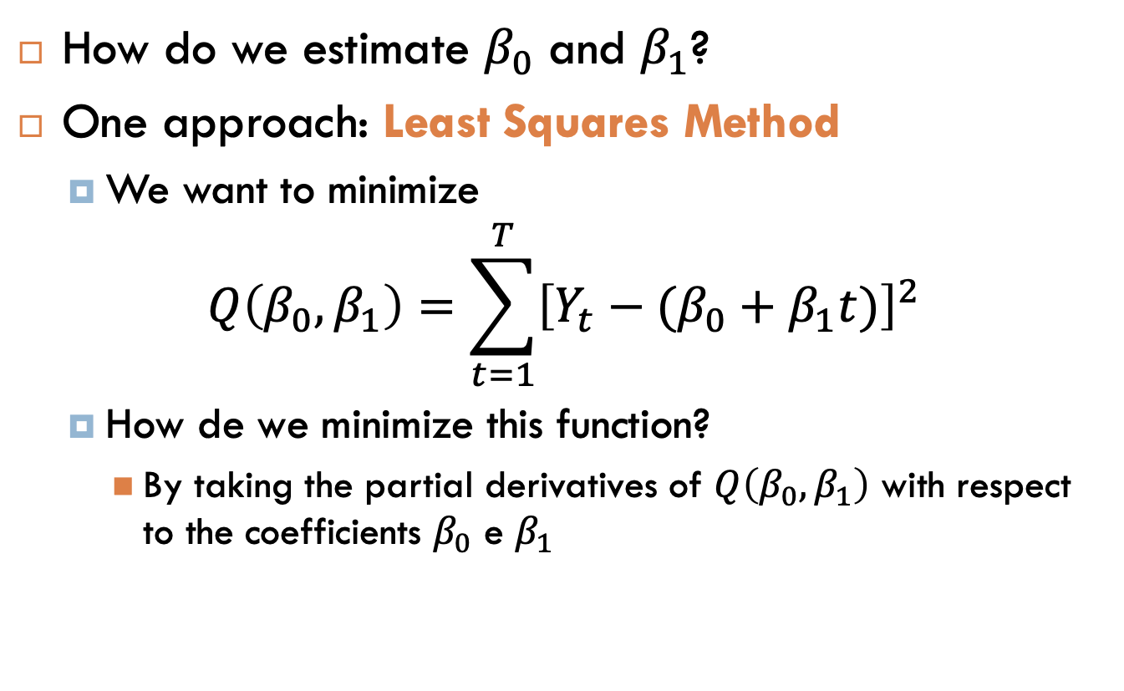
Linear Trend Estimation
How do we estimate $β_{0}$ and $β_{1}$?
One approach: Least Squares Method
We want to minimize
$$Q\left(β_{0},β_{1}\right)=\sum_{t=1}^{T}{{\left[Y_{t}−(β_{0}+β_{1}t)\right]}^{2}}$$
How de we minimize this function?
By taking the partial derivatives of $Q\left(β_{0},β_{1}\right)$ with respect to the coefficients $β_{0}$ e $β_{1}$

Slide 17
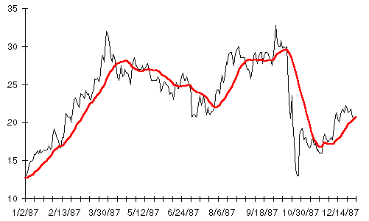
Non-Linear Trend Estimation: Moving Average
Smooth out the trend with something like a rolling average
A moving average trendline smooth out fluctuations in data to show a pattern or trend more clearly
Which order to use for the moving average?
Looking at the rolling average makes it easier to tell how the trend is moving underneath the noise
Notes:
If your rolling average considers the same window as your seasonal cycle, it washes out the seasonal cycle
Seasonal component will account for the differences between the original data and detrended data

Slide 18
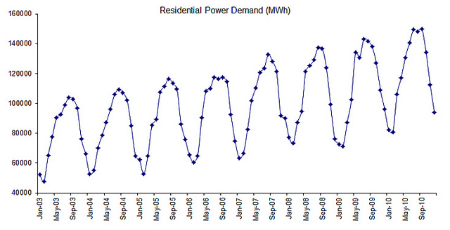
Seasonal Component
Short-term regular wave-like patterns
Observed within 1 year - monthly or quarterly
Equally spaced peaks and troughs
Calendar Related
Peaks in the Summer months Jun/Jul/Ago
Notes:
Calendar related movement – not necessarily season – weekday-weekend

Slide 19
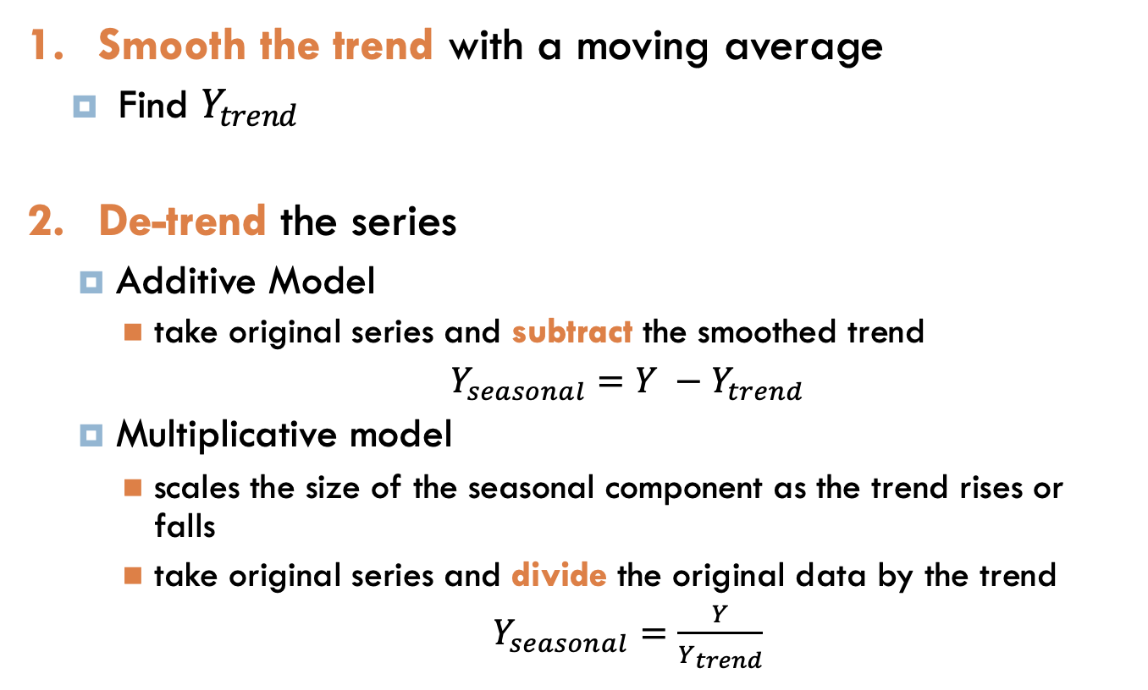
Decomposition: Trend Component
Smooth the trend with a moving average
Find $Y_{trend}$
De-trend the series
Additive Model
take original series and subtract the smoothed trend
$Y_{seasonal}=Y −Y_{trend}$
Multiplicative model
scales the size of the seasonal component as the trend rises or falls
take original series and divide the original data by the trend
$Y_{seasonal}=\frac{Y}{Y_{trend}}$

Slide 20
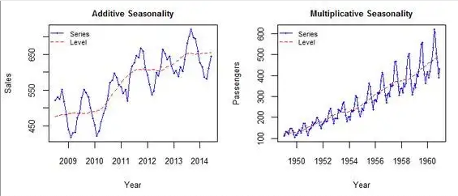
Additive vs Multiplicative Model
In the additive model the magnitude of seasonality does not change in relation to time
In the multiplicative model the magnitude of the seasonal pattern depends on the magnitude/level of the data.

Slide 21
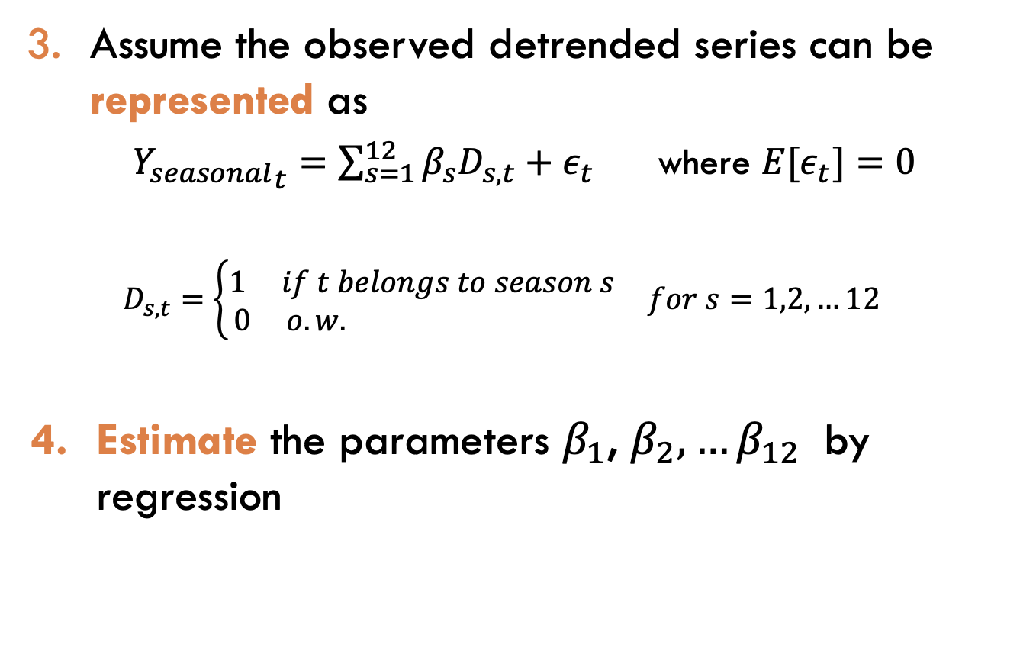
Decomposition: Seasonal Component
Assume the observed detrended series can be represented as
${Y_{seasonal}}_{t}=\sum_{s=1}^{12}{β_{s}D_{s,t}}+ε_{t}$ where ${E[ε}_{t}]=0$
$$D_{s,t}=\left\{\begin{matrix}1 if t belongs to season s \\ 0 o.w. \end{matrix}\right. for s=1,2,…12$$
Estimate the parameters $β_{1}$, $β_{2},…β_{12}$ by regression

Slide 22
Example: Inflow Data

Slide 23
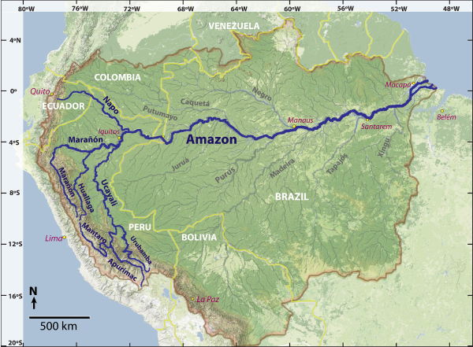
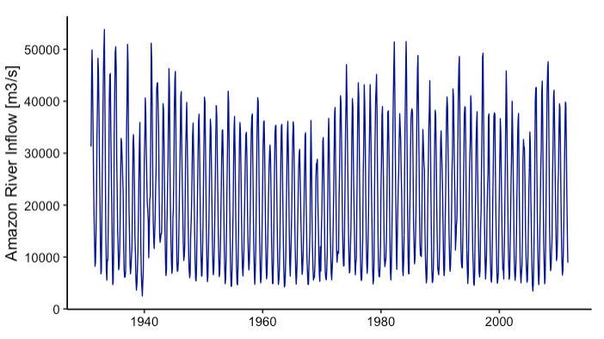
Amazon River Inflow in m³/s
Which components/patterns can you see in this series?

Slide 24
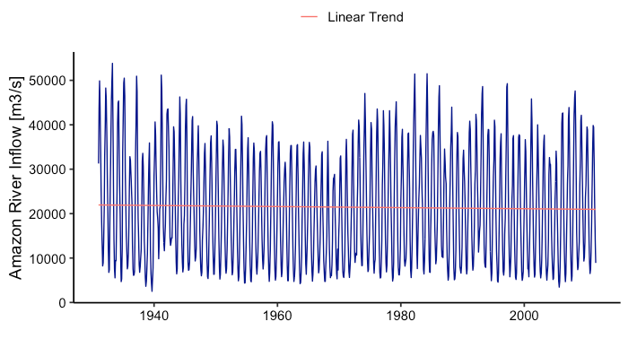

Linear Trend visualization
$${Y_{trend}}_{t}=β_{0}+β_{1}t$$
Notes:
Add regression results

Slide 25
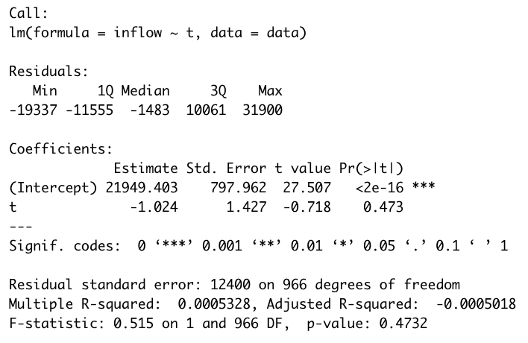

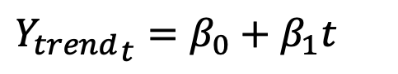
Linear Trend regression results
$${Y_{trend}}_{t}=β_{0}+β_{1}t$$
p-value > 0.05
Coefficient $β_{1}$ not significant
Notes:
Add regression results
Overall no increasing or decreasing trend on the mean
But it seems to be trending over time

Slide 26
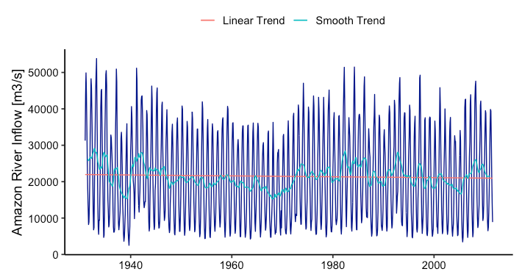
Smooth Trend: MA(6)
${Y_{trend}}_{t}=average(Y_{t−6}+Y_{t−5}+…+Y_{t}+…+ Y_{t+5}+Y_{t+6}$)
Notes:
What’s next?
Do we already have a good representation of our inflow data?
seasonal cycle that accounts for the differences between the original data and this season-less rolling average.

Slide 27
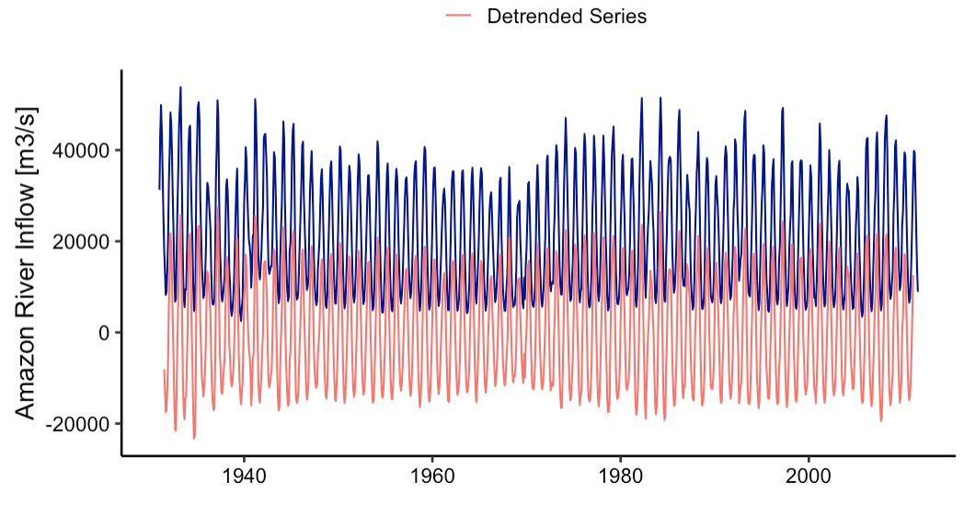
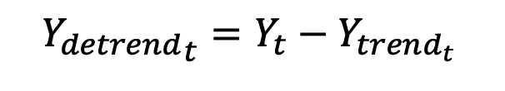
Detrended Series with Additive Model
$${Y_{detrend}}_{t}=Y_{t}−Y_{trend_{t }}$$

Slide 28

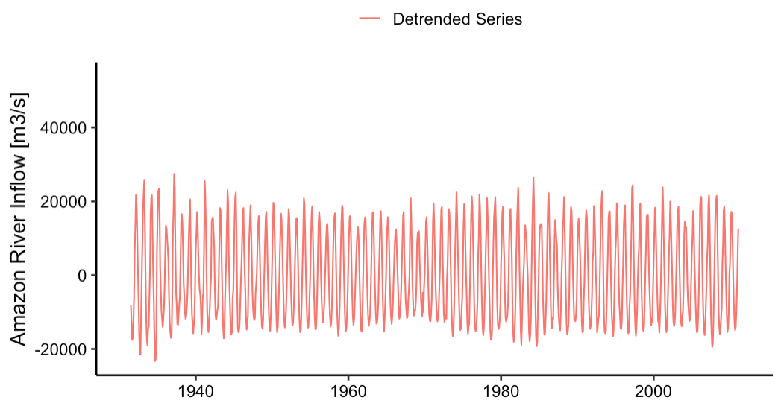
Do you still see any patterns?

Slide 29
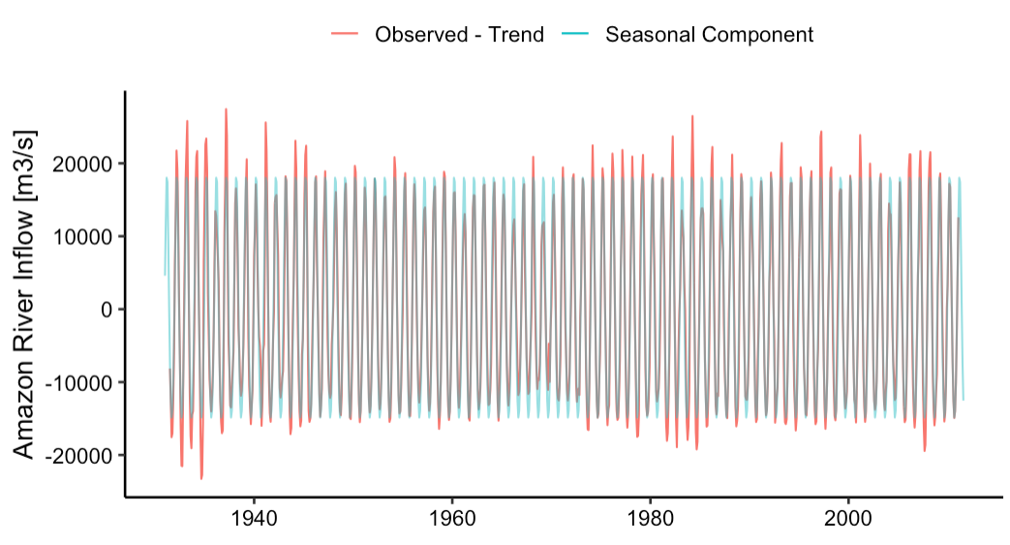
Seasonal Component Visualization

Slide 30
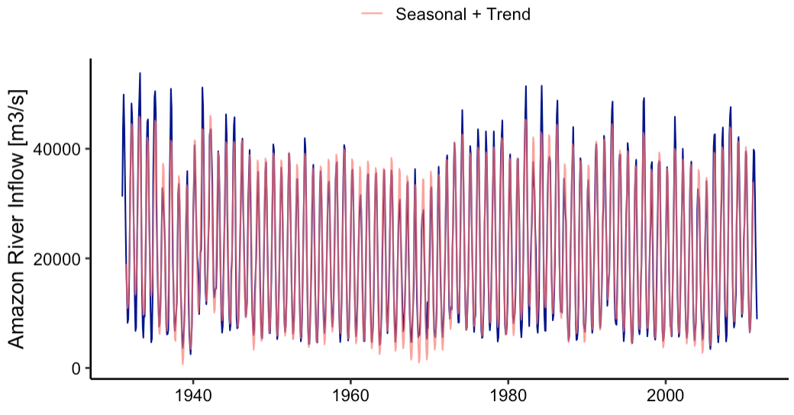
Seasonal + Trend Model of Inflow

Slide 31
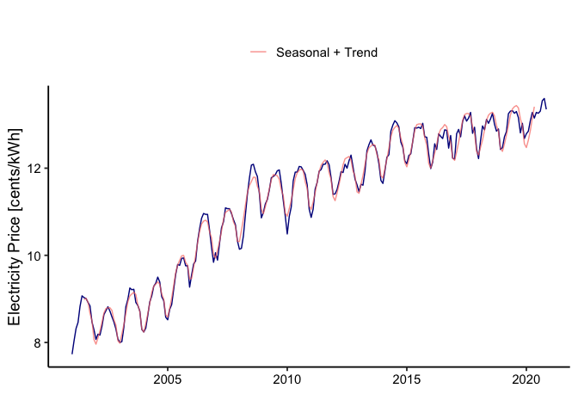
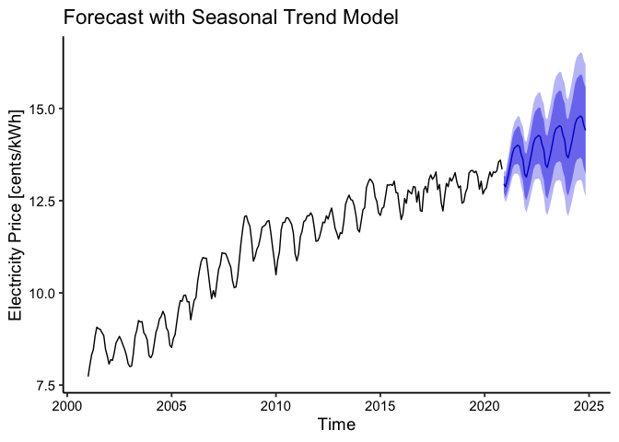

More Examples
Electricity Price – STL model
Please visit: https://github.com/ENV790/TSA_Intro_EDAL

Slide 32
Forecasting and Model Selection

Slide 33
Time Series Forecasting
Forecast/Projection statement about the future value/probability distribution of a variable of interest
Forecasts are often used for weather, demand, and resource availability
Important element in making informed decisions
uses past values of a time series to estimate future values of the same time series

Slide 34
Two Important Aspects of Forecasts
Expected level
Ex: the level of demand may be a function of some structural variation such as trend or seasonal variation
Accuracy
Related to the potential size of forecast error

Slide 35
Features Common to All Forecasts
Techniques assume some underlying causal system that existed in the past will persist into the future
Forecasts are not perfect
it is important to provide an indication of the extent to which the forecast might deviate from the value of the variable that actually occurs
Forecasts for groups of items are more accurate than those for individual items
Forecast accuracy decreases as the forecasting horizon increases

Slide 36

Model Selection
“Unsolved” problem in statistics: there are no magic procedures to get you the “best model” (Kadane and Lazar)
With a limited number of predictors, it is possible to search all possible models
But when we have many predictors, it can be difficult to find “best” model (many possibilities)
How do we select models?
We need a criteria or benchmark to compare two models
We need a search strategy

Slide 37

Model Selection
Which models best explain the observed data?
Which models give the best predictions of future observations?
Backward-looking assessment
Residual Analysis: describes the difference between actual historical data and the fitted values generated by a statistical model
Akaike Information Criterion (AIC): balance goodness of fit and the simplicity of the model
Forward-looking assessment
Forecast accuracy is an important forecasting technique selection criterion
Error = Actual – Forecast
Root Mean Squared Error (RMSE)
Mean Absolute Percentage Error (MAPE)
Need to hold-out some observed data to test forecast accuracy
Observed value
Always combine metrics!

Slide 38

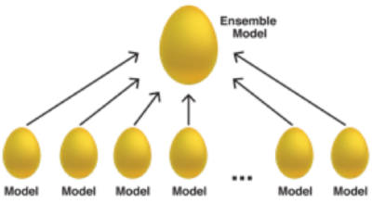
How to choose the best model?
Build a set of candidate models and use model selection/performance criteria to pick one
To improve forecasting accuracy, combine forecasts derived from models that differ in construction and predictor variables
ENSEMBLE

Slide 39
Additional Resources
Time Series Analysis for Energy and Environment Applications
Spring 2023 Course website: https://env790.github.io
Environmental Data Analytics
Spring 2023 Course website: https://env872.github.io

Slide 40
THANK you !
luana.marangon.lima@duke.edu
Energy Data Analytics PhD Student Fellows Workshop
Durham, June 15th 2023

